Slide 1
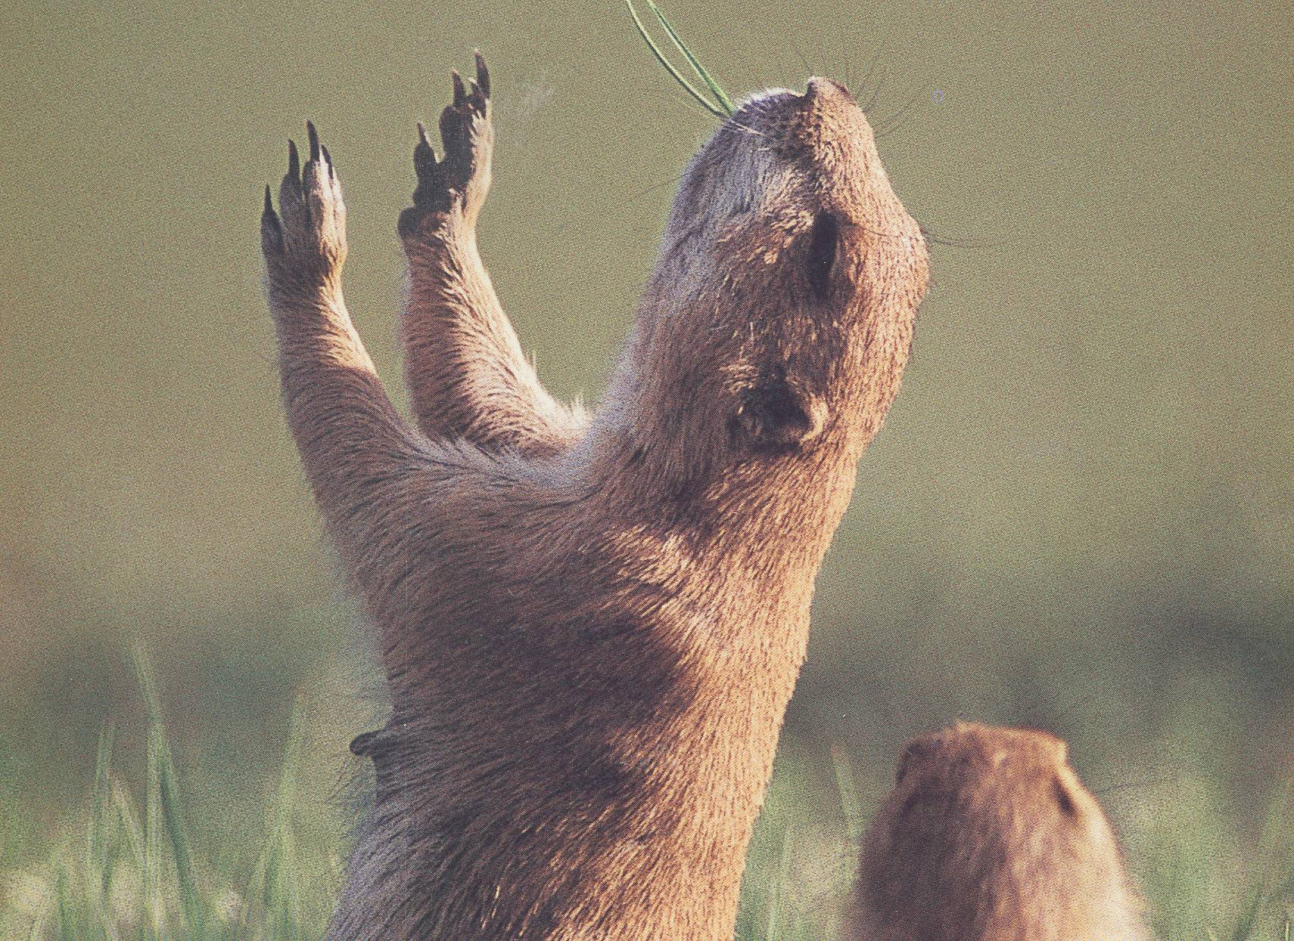

Slide 2
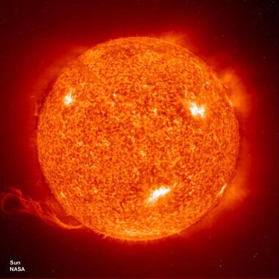
ENERGY FROM
THE SUN

Slide 3

What are the three ways energy is transferred?

Slide 4
What happens if you walk barefoot across blacktop during the summer?
This is an example of what type of energy transfer?
Conduction:
because the heat is transferring from the blacktop to your feet. This would continue until your feet are the same temperature as the blacktop.

Slide 5
What type of energy transfer would be if you are warming yourself by a campfire?
Radiation:
Because the heat is being transferred to you by electromagnetic waves.

Slide 6

The upward movement heated air above a campfire is an example of what type of energy transfer?
Convection:
Because there is the movement of air.
Anytime there is movement of gases or liquids it will be convection.

Slide 7
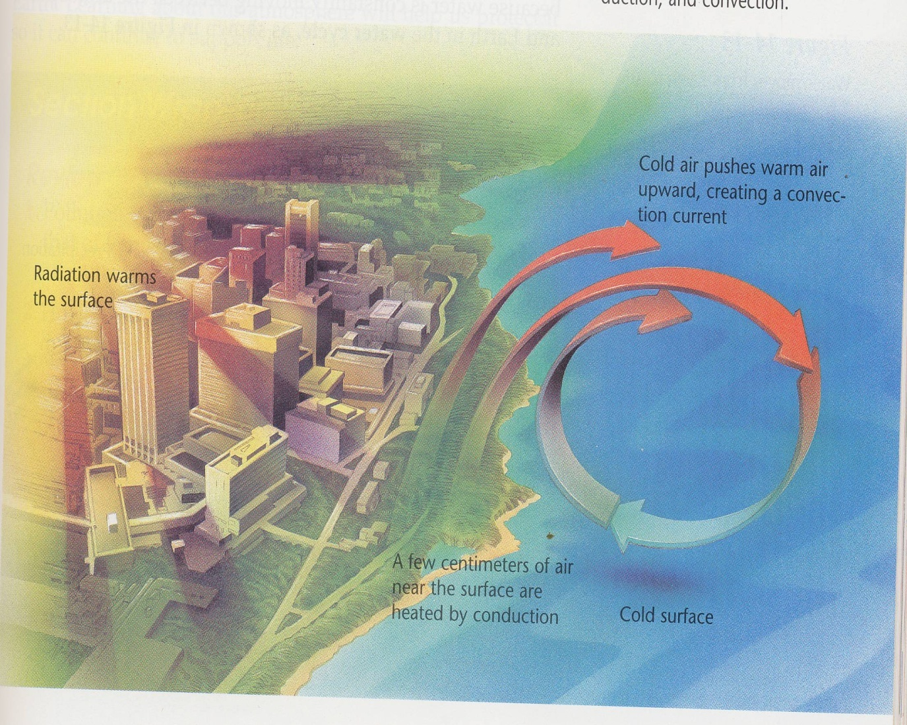
Energy from the sun is transferred by…
Radiation
- Electromagnetic waves
Conduction
- Direct contact
    Convection
- Flow of liquid or air
Where is radiation, conduction, and convection happening?

Slide 8
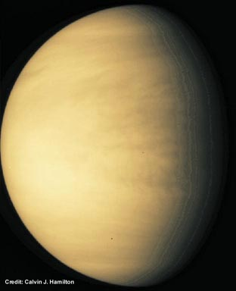
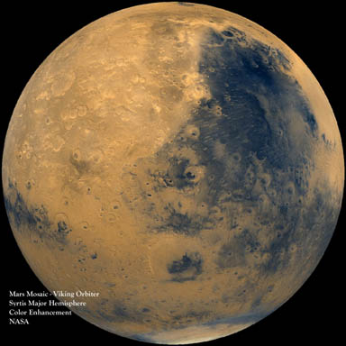
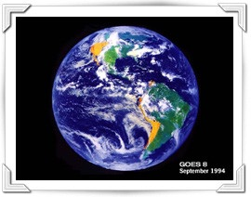
Energy from the sun is reflected, absorbed, or scattered.
Earth’s atmosphere creates a delicate balance between energy received and energy lost.
On Mars, a thin atmosphere allows much of the radiation to escape.
Most radiation entering Venus’s atmosphere is trapped by thick gases and clouds.

Slide 9
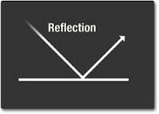
Reflection
Light bounces off an object with no transfer of energy.

Slide 10
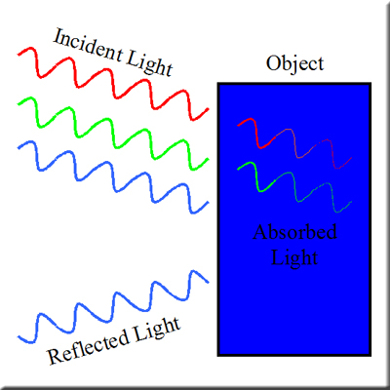
Absorption
Light strikes an object and is converted to heat energy.

Slide 11
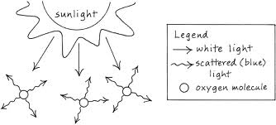
Scattering
Light is refracted by an object, resulting in multiple rays of weaker energy.

Slide 12
Albedo
A measure of how much light energy is reflected by a surface.
An albedo near 1 or 100% is highly reflective.
An albedo near 0 or 0% is non reflective.

Slide 13
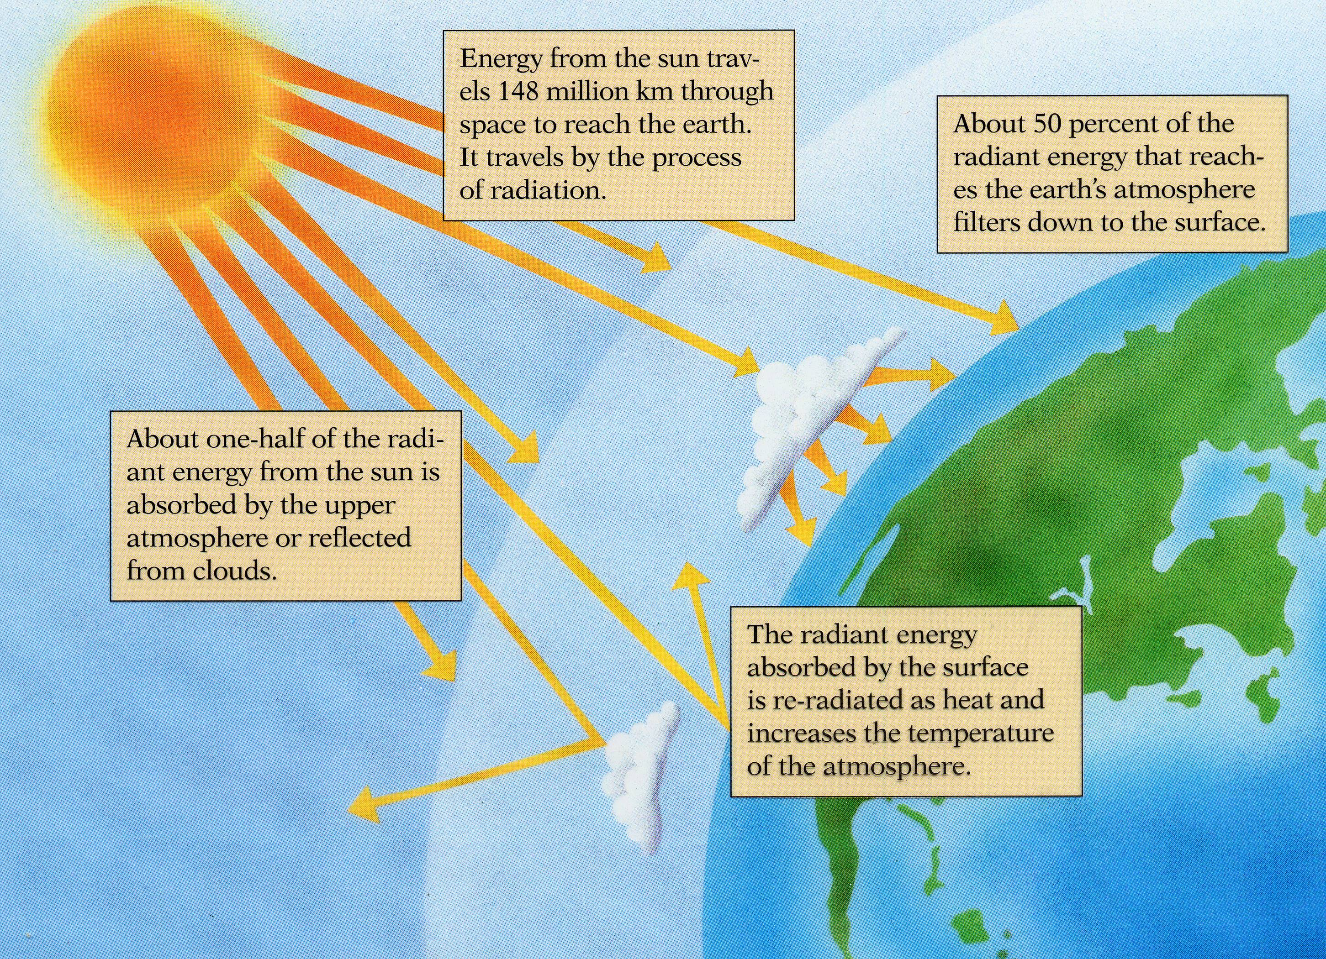

Slide 14
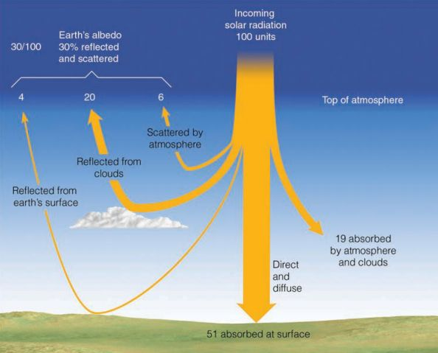

Slide 15
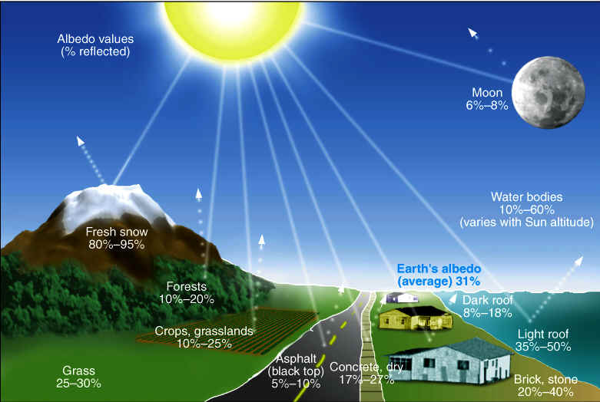

Slide 16
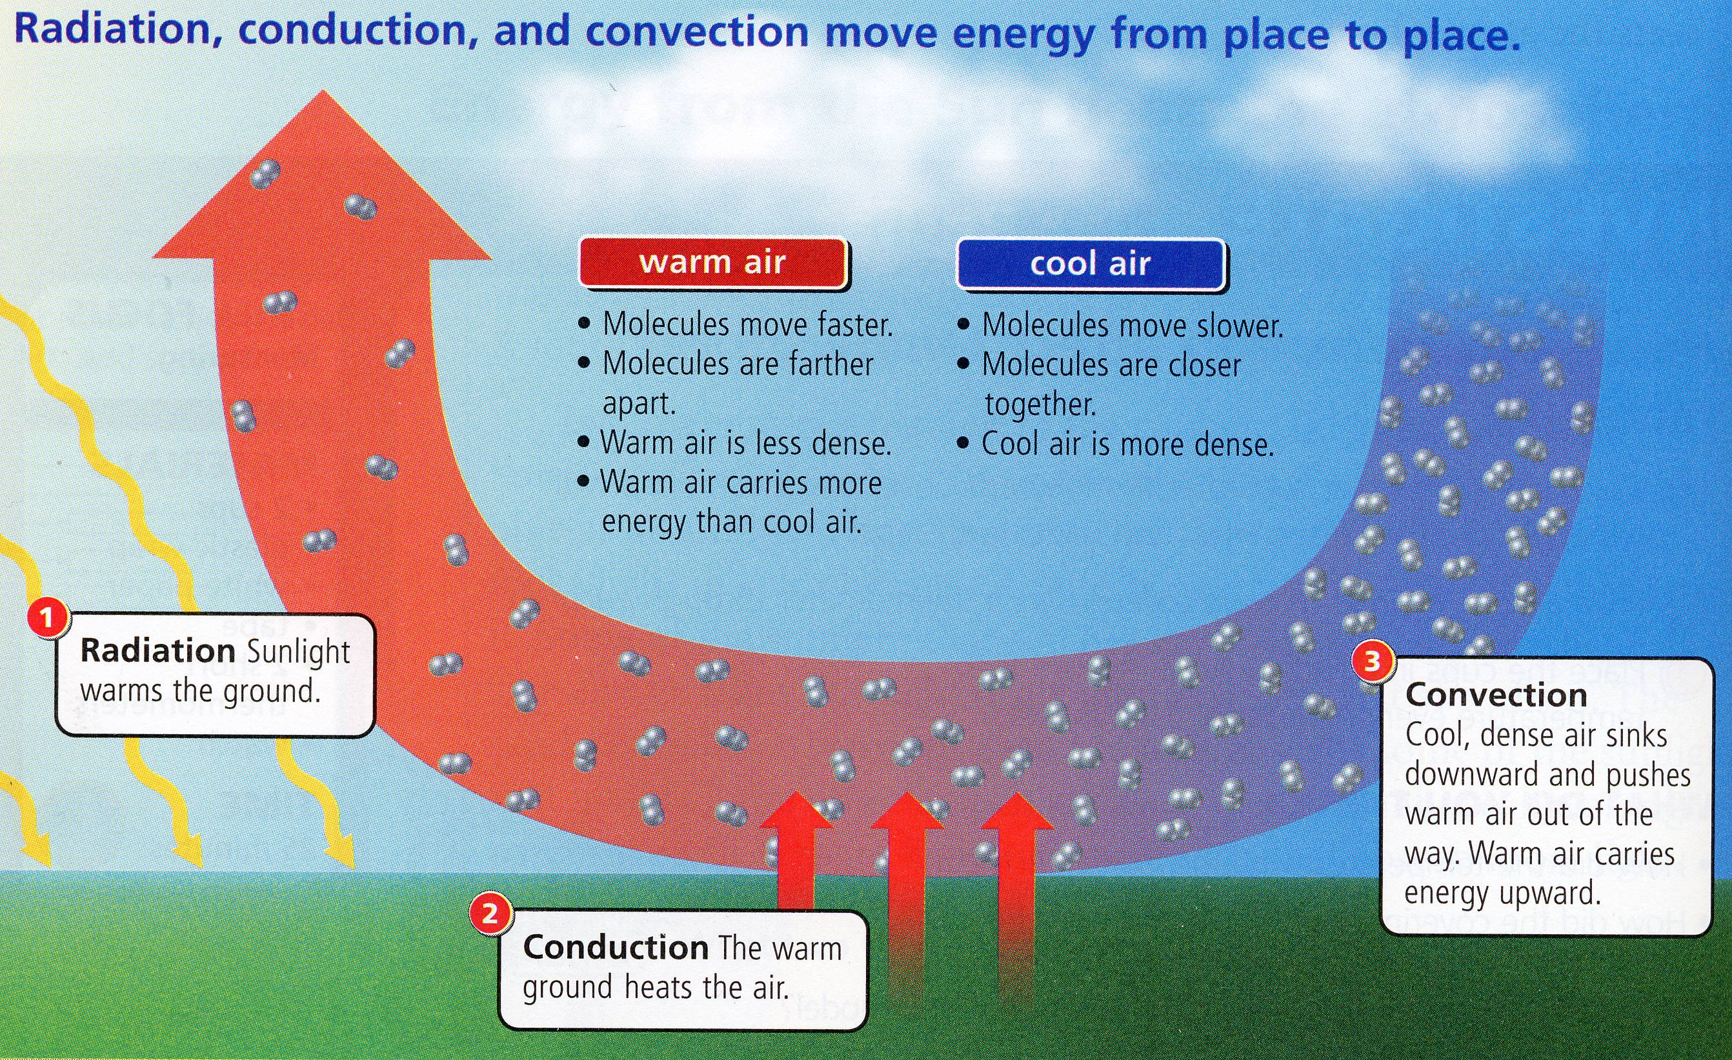

Slide 17
The Four Seasons
Is the changing seasons caused by the change in the distance between the Sun and the Earth?
No. If it is, then
  The northern and southern hemisphere should have the same season, not opposite season like we have.
  We should experience real seasonal changes in Hawaii also.

Slide 18
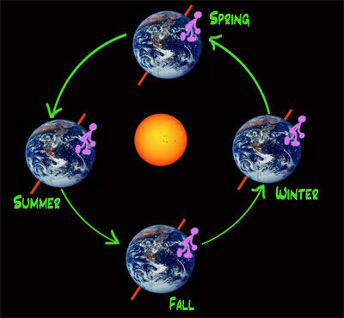

Slide 19
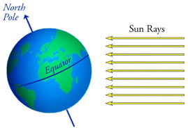

Slide 20
