Slide 1
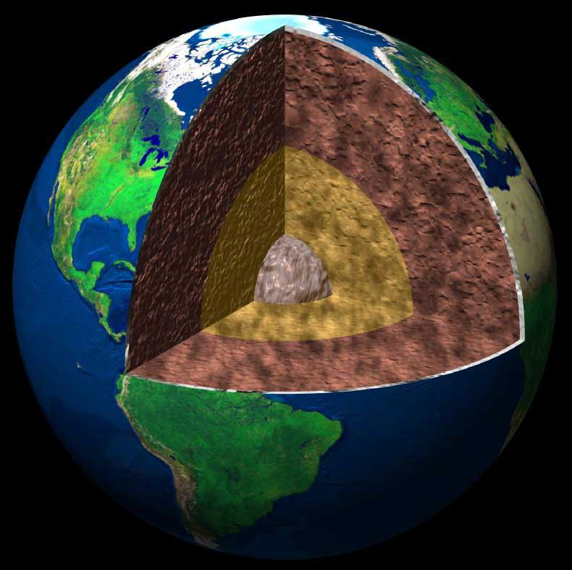
Earth’s Internal Structure
Standard 2 Objective 1
Indicators: A and B

Slide 2
Why is Earth’s interior hot?
There are two reasons why the Earth’s interior remains hot.
Radioactive decay.
Heat of formation
Gravitational collapse.
Constant bombardment.

Slide 3
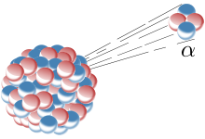
Radioactive decay
About 50% of the Earth’s interior heat comes from the decay of radioactive materials.
As unstable isotopes decay into more stable elements, heat is produced.

Slide 4
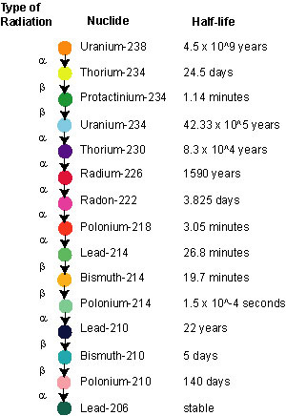

Slide 5
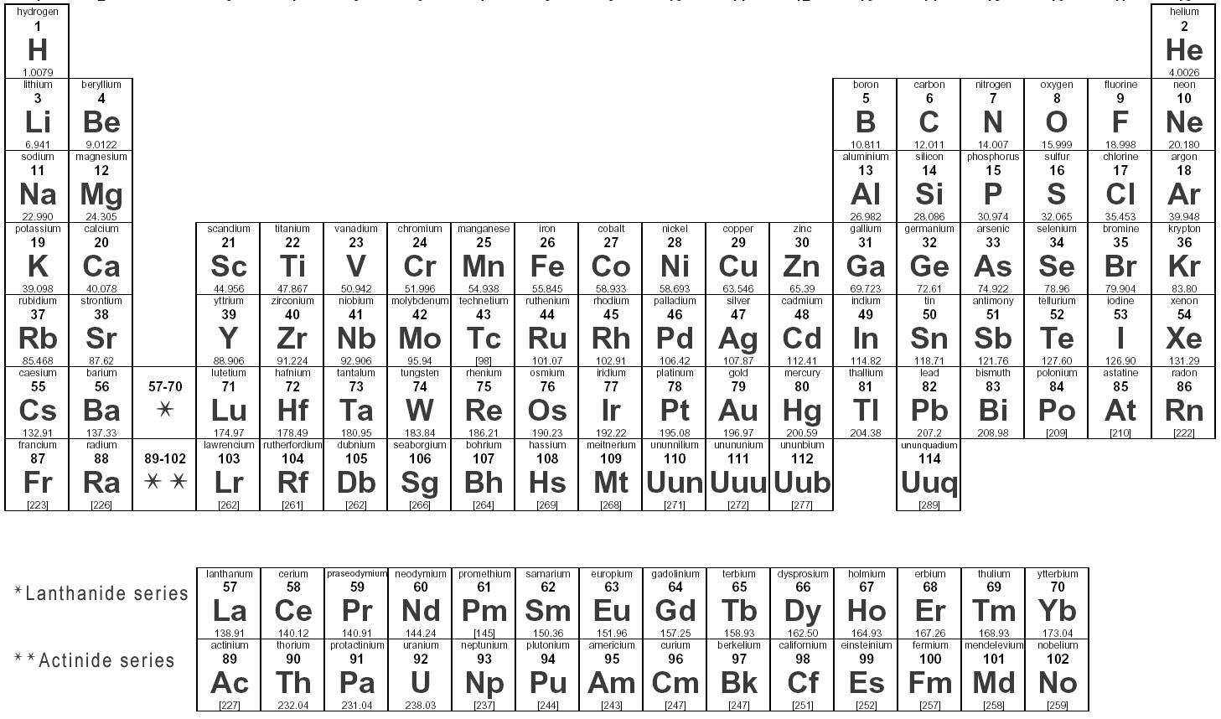

Slide 6
Radioactive decay
Elements such as Uranium-238
Alpha decay: alpha particle (Helium nucleus) is emitted. Element loses 2 protons and 2 neutrons.
Beta decay: beta particle (electron ) is emitted. One neutron is converted into a proton.

Slide 7
The grid below represents a quantity of U²³⁸. Each time you click,
one half-life goes by. Try it!
U²³⁸ – blue PB²⁰⁶ - red
Half lives | % U²³⁸ | %Pb²⁰⁶ | Ratio of U²³⁸ to Pb²⁰⁶
0 | 100% | 0% | no ratio
As we begin notice that no time
has gone by and that 100% of the
material is U²³⁸
Age = 0 half lives (4.5 billion years x 0 = 0 yrs)

Slide 8
The grid below represents a quantity of U²³⁸. Each time you click,
one half-life goes by. Try it!
U²³⁸ – blue PB²⁰⁶ - red
Half lives | % U²³⁸ | %Pb²⁰⁶ | Ratio of U²³⁸ to Pb²⁰⁶
0 | 100% | 0% | no ratio
1 | 50% | 50% | 1:1
After 1 half-life (4.5 by ), 50% of
the U²³⁸ has decayed into Pb²⁰⁶. The ratio
of U²³⁸ to Pb²⁰⁶ is 1:1. There are equal
amounts of the 2 elements.
Age = 1 half lives (4.5 billion x 1 = 4.5 billion years )

Slide 9
The grid below represents a quantity of U²³⁸. Each time you click,
one half-life goes by. Try it!
U²³⁸ – blue PB²⁰⁶ - red
Half lives | % U²³⁸ | %Pb²⁰⁶ | Ratio of U²³⁸ to Pb²⁰⁶
0 | 100% | 0% | no ratio
1 | 50% | 50% | 1:1
2 | 25% | 75% | 1:3
Now 2 half-lives have gone by for a total
of 11,400 years. Half of the U²³⁸ that was
present at the end of half-life #1 has now
decayed to Pb²⁰⁶. Notice the U:Pb ratio. It
will be useful later.
Age = 2 half lives (4.5 billion x 2 = 9 billion years)

Slide 10
The grid below represents a quantity of U²³⁸. Each time you click,
one half-life goes by. Try it!
U²³⁸ – blue PB²⁰⁶ - red
Half lives | % U²³⁸ | %Pb²⁰⁶ | Ratio of U²³⁸ to Pb²⁰⁶
0 | 100% | 0% | no ratio
1 | 50% | 50% | 1:1
2 | 25% | 75% | 1:3
3 | 12.5% | 87.5% | 1:7
After 3 half-lives (13.5 by) only
12.5% of the original U²³⁸ remains. For
each half-life period half of the material
present decays. And again, notice the
ratio, 1:7
Age = 3 half lives (4.5 billion x 3 = 13.5 billion years)

Slide 11
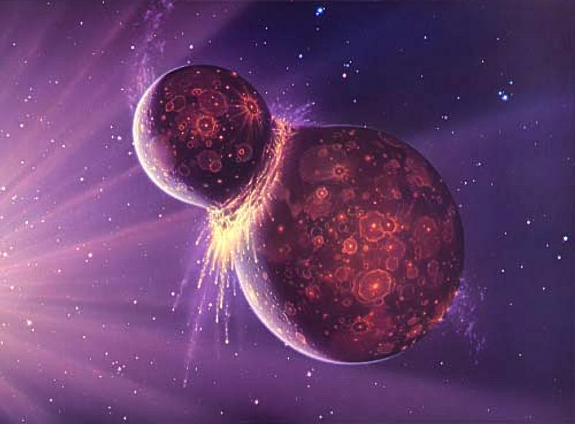
Heat of formation
According to Nebular Theory, Earth formed from the accretion of rocks during the formation of the solar system.
This constant bombardment produced heat which kept the interior molten.
After crust developed less heat was lost.

Slide 12
Gravitational collapse
Early Earth was less dense and not homogeneous.
As gravity caused the heavier metals and material to settle, friction created heat.

Slide 13
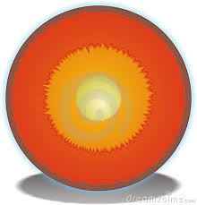
Composition of Interior Earth
What are the major layers of Earth’s interior?
Crust
Mantle
Outer core
Inner core

Slide 14
Composition of Interior Earth Crust
Outer layer of the Earth.
Thin. 3-25 miles (5-32 km)
Cool at the surface, up to 1600 F (870 C) at the deepest portions.
Broken up into tectonic plates.

Slide 15
Composition of Interior Earth Mantle
Just underneath the crust.
1800 miles thick.
1600 to 4000 Fahrenheit.
Plastic: solid, but flows slightly due to pressure. (Like Modeling Clay)
Plasticity is reason plates are able to move.

Slide 16
Composition of Interior Earth Outer Core
Below the mantle
4000 to 9000 Fahrenheit.
Nickel and Iron
Liquid
1800 miles below crust and1400 miles thick.

Slide 17
Composition of Interior Earth Inner Core
Center of the Earth.
9000 Fahrenheit.
Pressure and temperature so high, Nickel and Iron are forced into solid.
4000 miles below crust and 800 miles thick.

