Slide 1

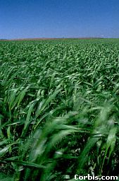
Wind Formation
Wind is caused by uneven heating of Earth and its atmosphere.
Wind is air moving from areas of high pressure to areas of low pressure.

Slide 2
Identify the areas that have warm and cold air.

Slide 3
Which area has the most dense air?
Cold Air
Warm Air

Slide 4
Which sides have high and low air pressures?
Cold Air
Warm Air
Dense Air
Less Dense Air

Slide 5
What is the rule for atmospheric pressure reaching equilibrium?
Cold Air
Warm Air
Dense Air
Less Dense Air
High Air Pressure
Low Air Pressure

Slide 6
Which way will the air molecules begin to move?
Cold Air
Warm Air
Dense Air
Less Dense Air
High Air Pressure
Low Air Pressure

Slide 7
When will the air movement stop?
Cold Air
Warm Air
Dense Air
Less Dense Air
High Air Pressure
Low Air Pressure

Slide 8
The atmosphere is now at equlibrium.

Slide 9
The movement of air is called ____?
wind
Cold Air
Warm Air
Dense Air
Less Dense Air
High Air Pressure
Low Air Pressure

Slide 10
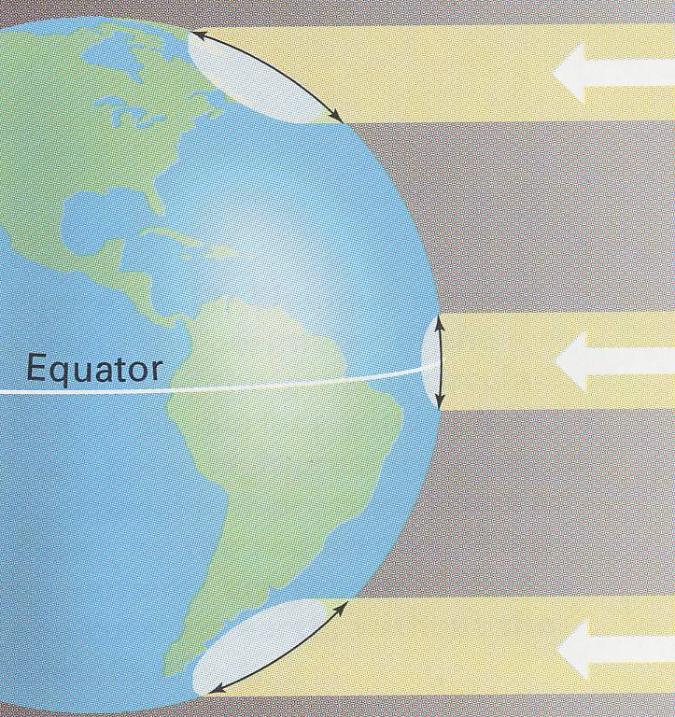
Which area receives direct sunlight (A, B, or C)?
A
The poles always receive indirect sunlight (light hits at an angle).
B
The equator always receives direct sunlight.
C

Slide 11
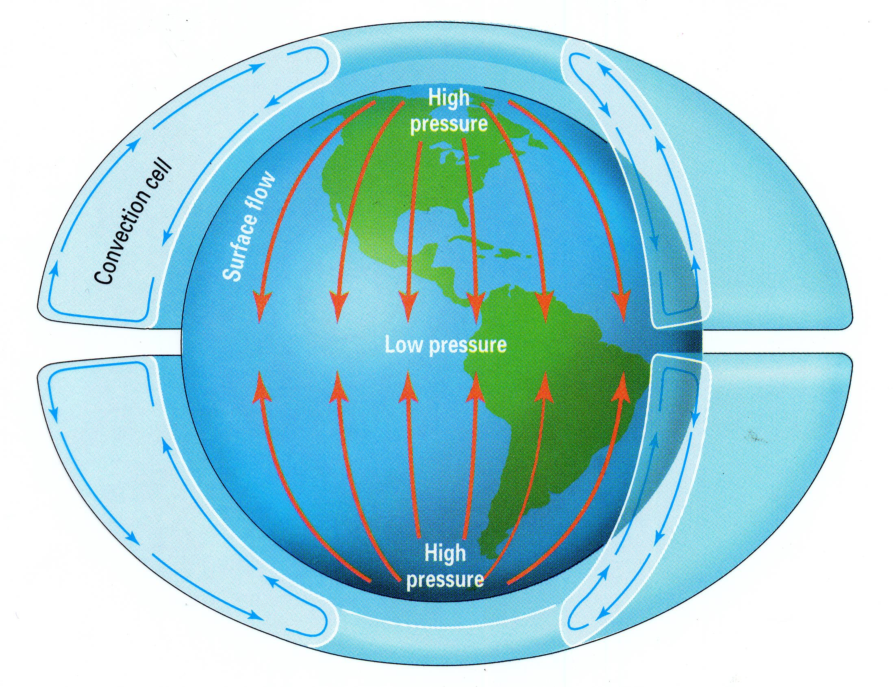
Cold Air
Convection Current
Convection Current
Warm Air
Warm Air
Convection Current
Convection Current
Cold Air

Slide 12
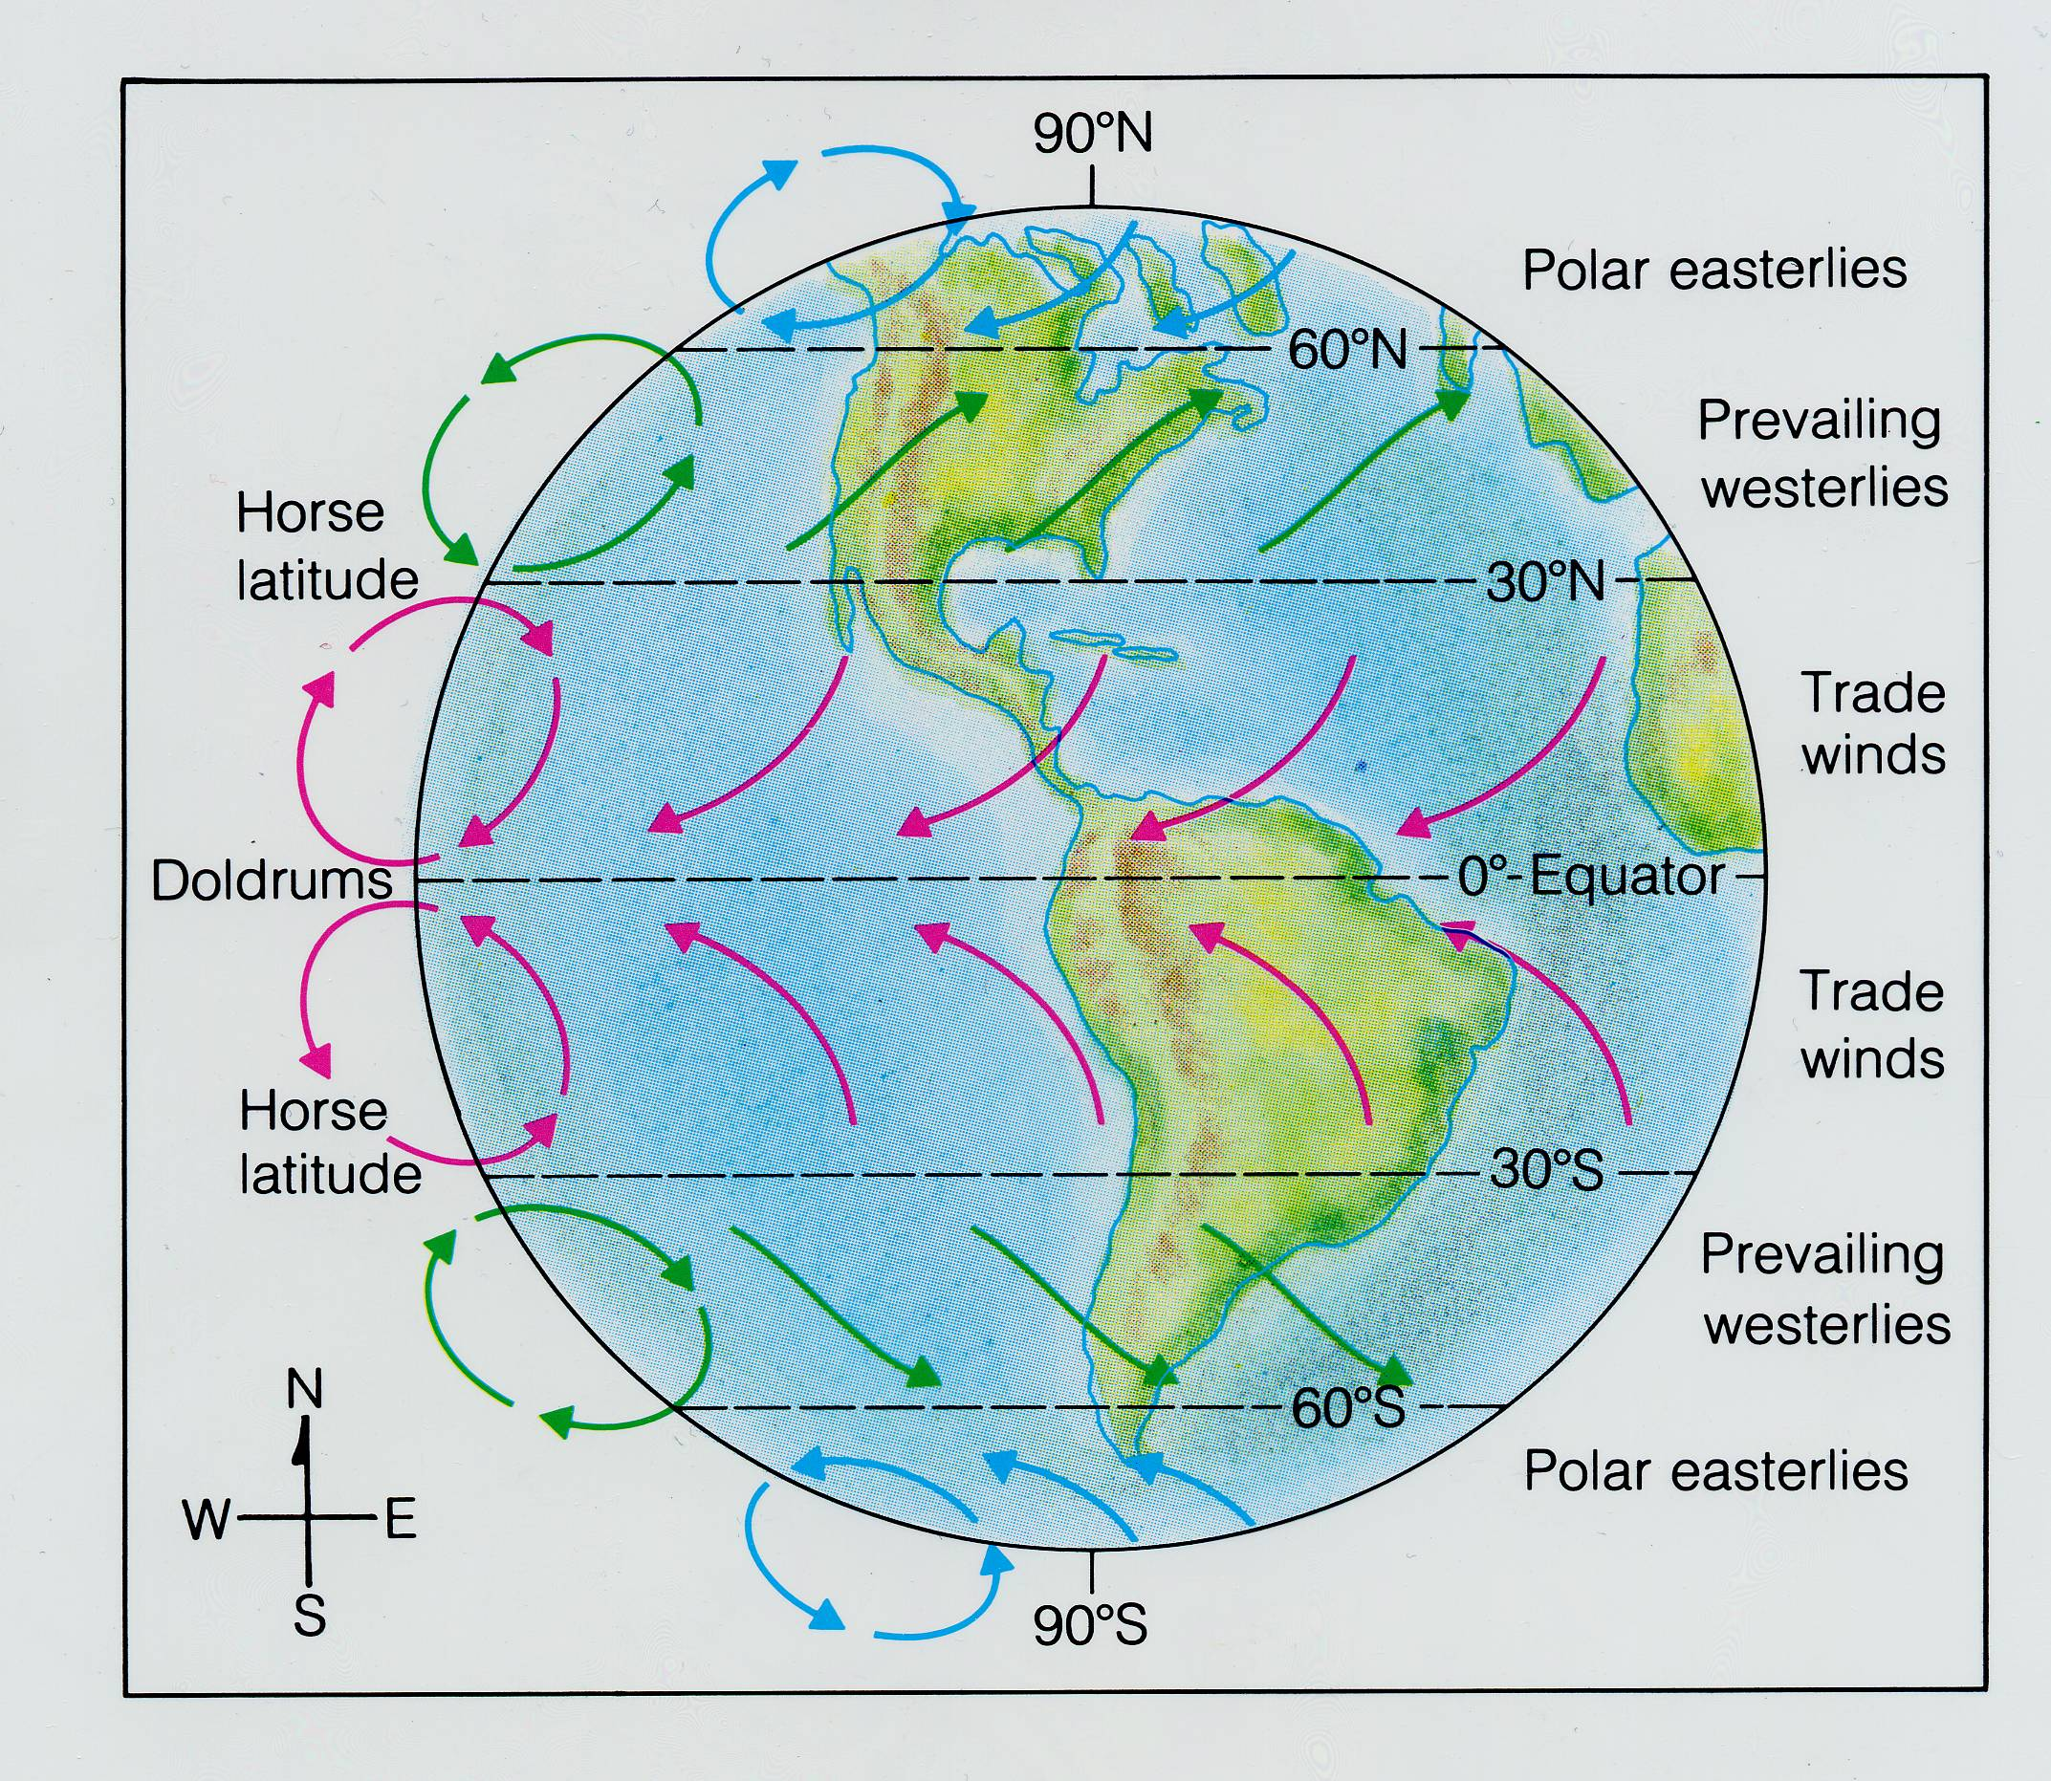
Wind Systems

Slide 13
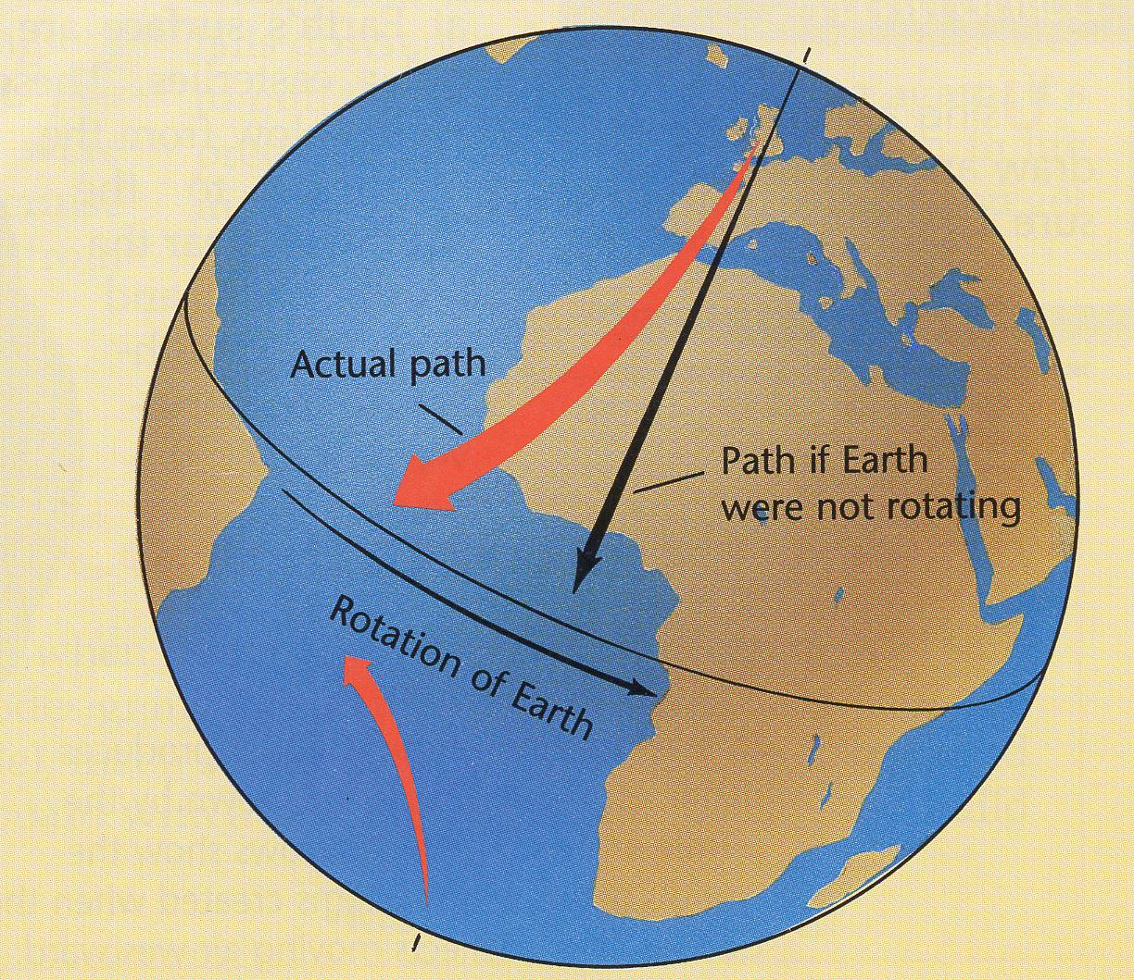
Coriolis Effect:
Winds, and weather patterns curve due to Earth’s rotation.

Slide 14
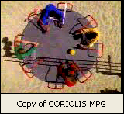
https://www.youtube.com/watch?v=i2mec3vgeaI
https://www.youtube.com/watch?v=aeY9tY9vKgs

Slide 15
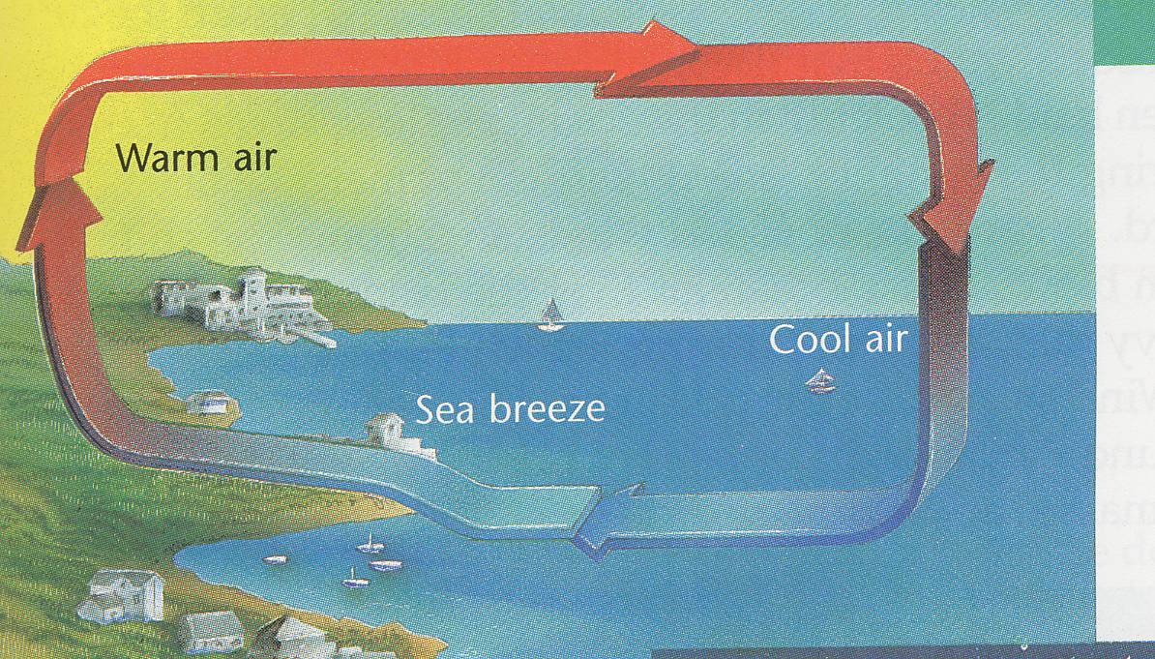
CONVECTION CURRENT
DAYTIME
LP
WIND DIRECTION
HP
SEA BREEZE
CONVECTION CURRENT

Slide 16
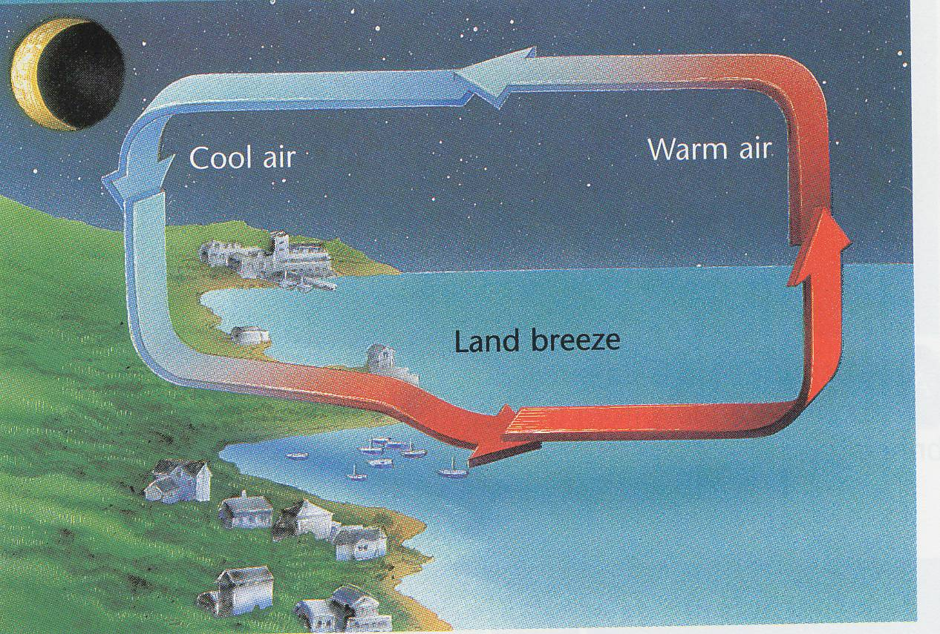
CONVECTION CURRENT
NIGHTTIME
HP
LP
WIND DIRECTION
LAND BREEZE
CONVECTION CURRENT

Slide 17
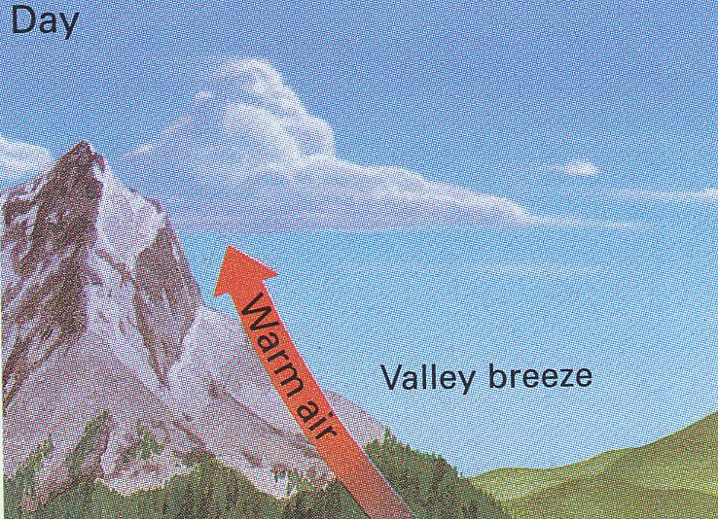
Warm air rises upslope during the daytime.

Slide 18
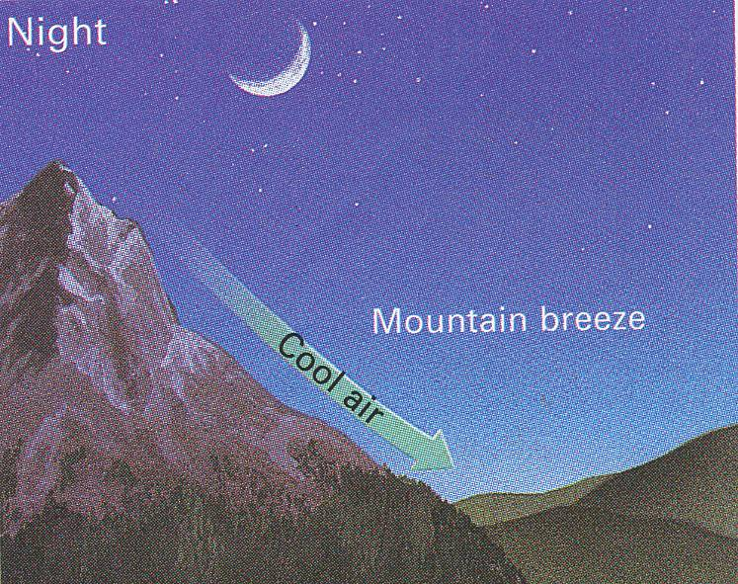
Cool air sinks down-slope during the night-time.

Slide 19
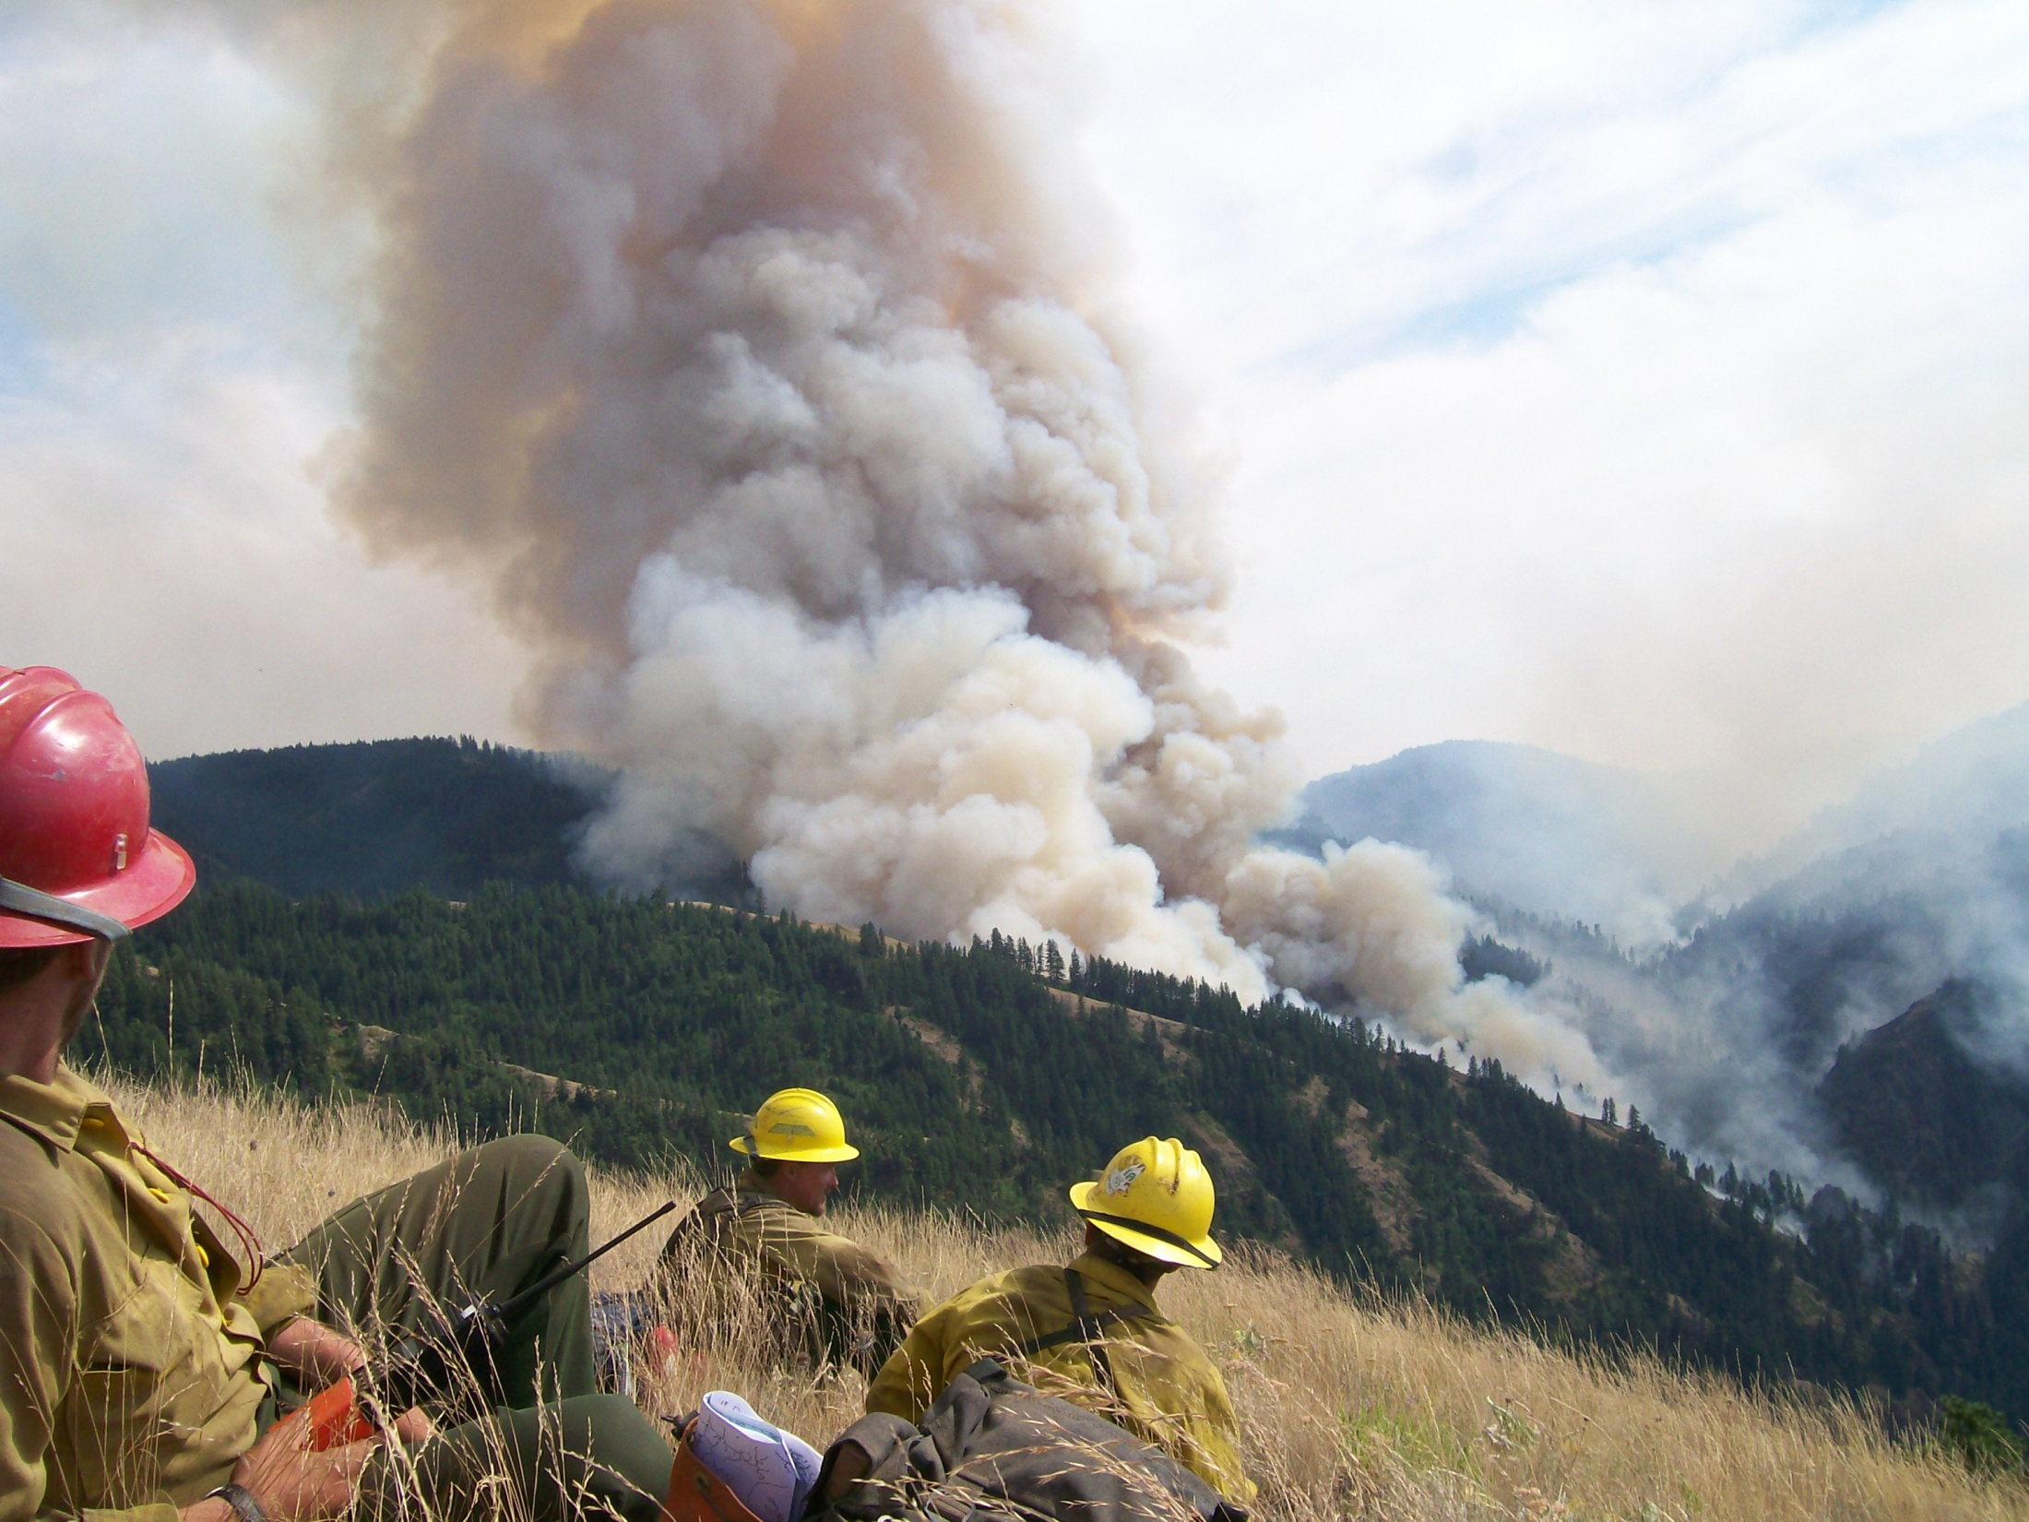
From what you have just learned about wind in valleys, where should these firefighters approach the fire and why?

Slide 20
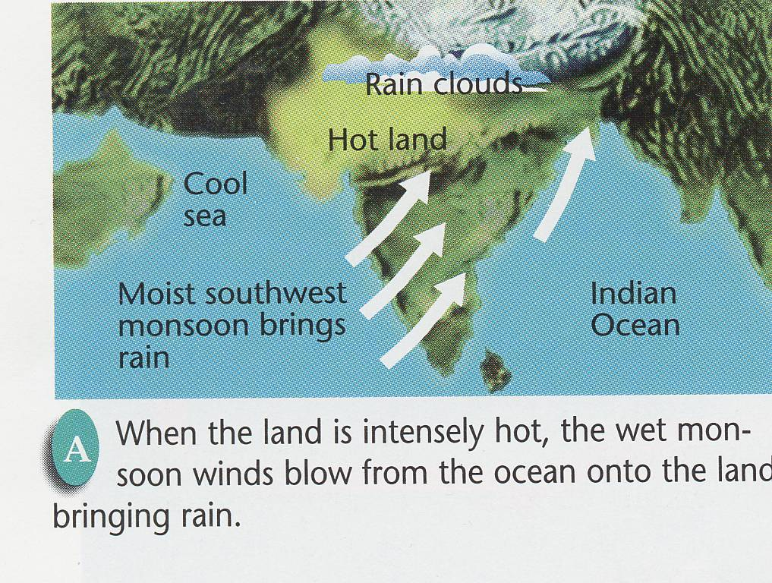
When land is intensely hot, the wet monsoon winds blow from the ocean onto the land bringing rain.

Slide 21
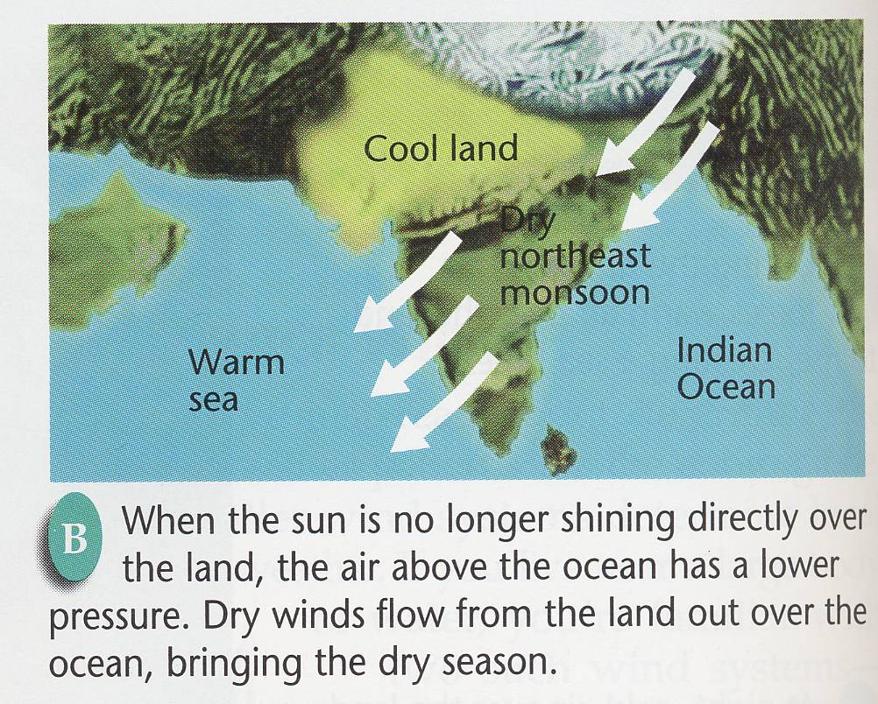
When the sun is no longer shining directly over the land, the air above the ocean has a lower air pressure. Dry winds flow from the land out over the ocean, bringing the dry season.

