Slide 1
COMPOSITION OF ATMOSPHERE
Gases
Nitrogen—78%, Oxygen—21%
Trace—1% (CO₂--.03% , Argon--.93%, Water Vapor 0—.4%, Neon, Helium, Methane, Hydrogen & Ozone)

Slide 2

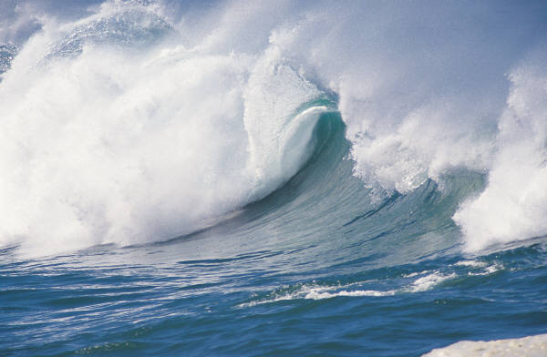

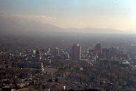
SOLIDS
Dust
Salt
Ice

Slide 3

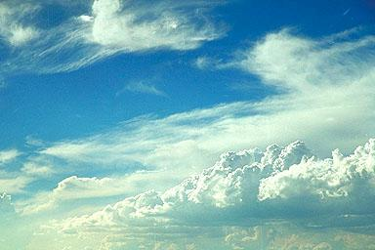
LIQUIDS
The most common liquid in the atmosphere is water found in droplets of clouds.

Slide 4
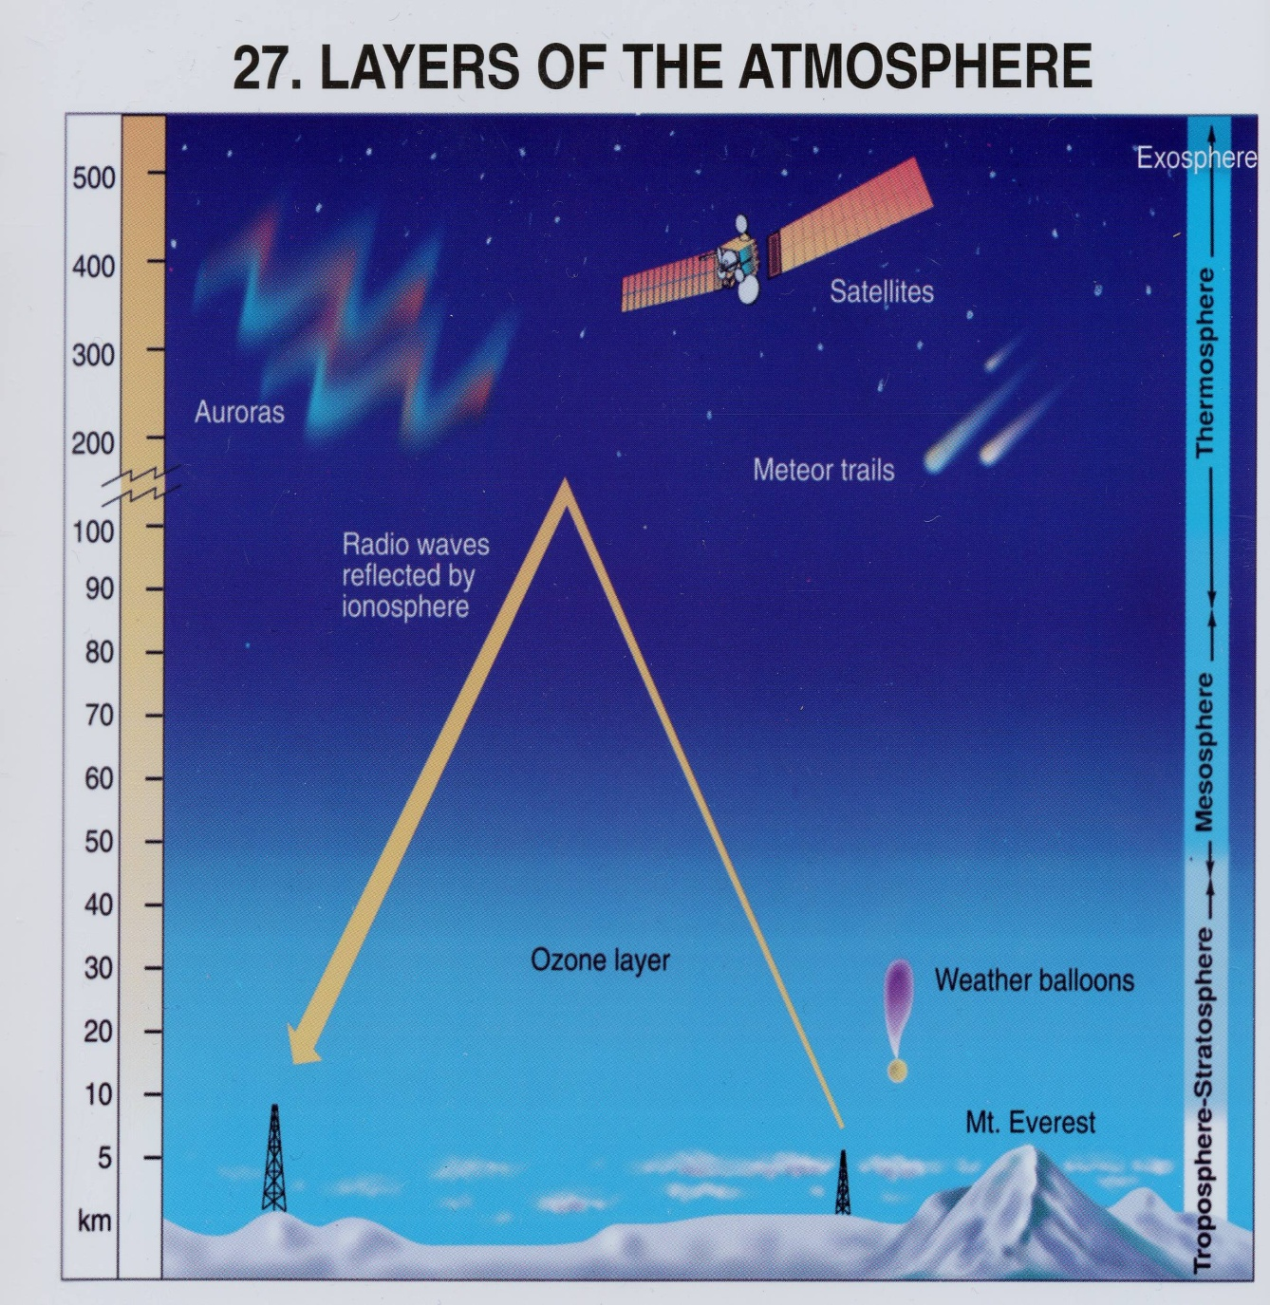
LAYERS OF THE ATMOSPHERE
Exosphere: Satellites orbit here. No definite boundary.
Ionosphere: Contains charged particles called ions (Aurora Borealis is found here).
Thermosphere: Contains the Ionosphere & Exosphere.
Mesosphere: Protects surface from most asteroids.
Stratosphere: Ozone near the top. Contain jet stream.
Troposphere: contains 75% of all gasses, supports life

Slide 5
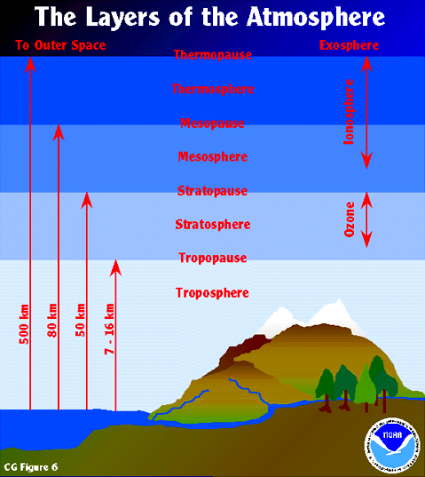

Slide 6
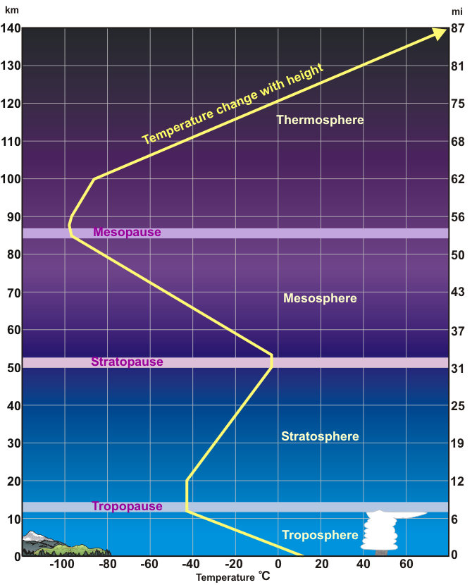

Slide 7
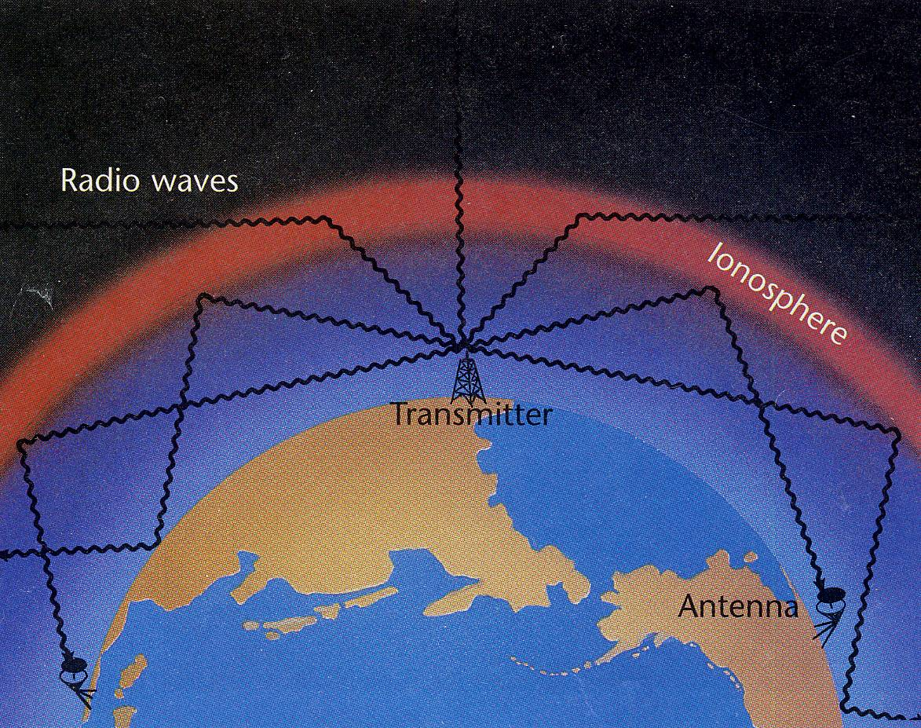
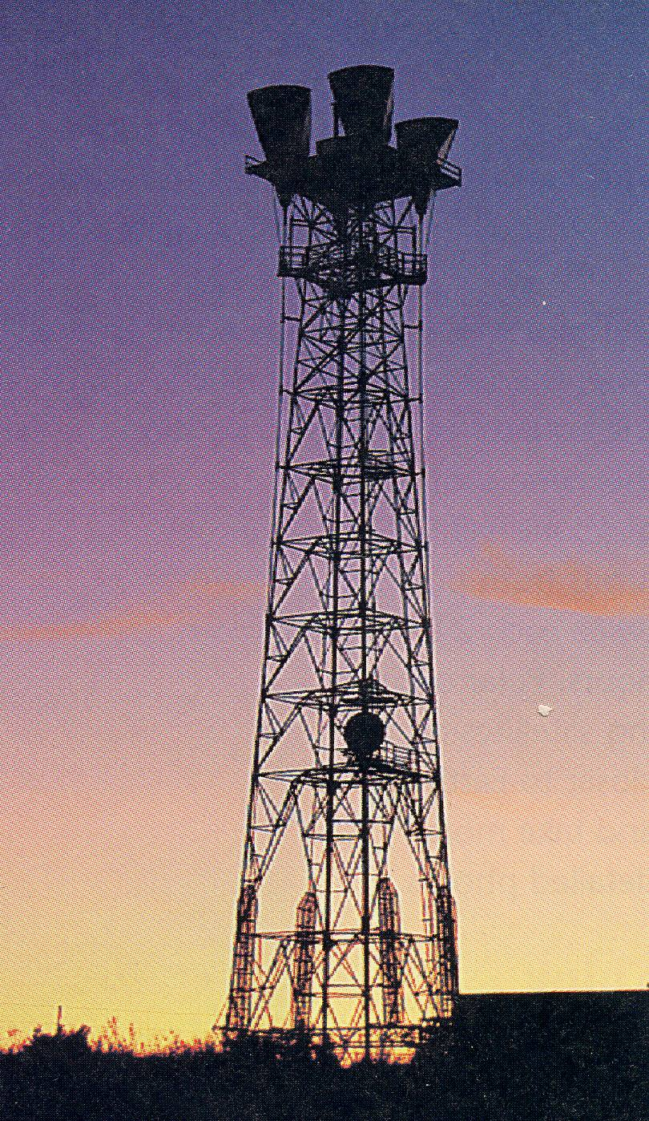
Radio waves can be transmitted around the globe by bouncing waves off the ionosphere to transmitters.

Slide 8
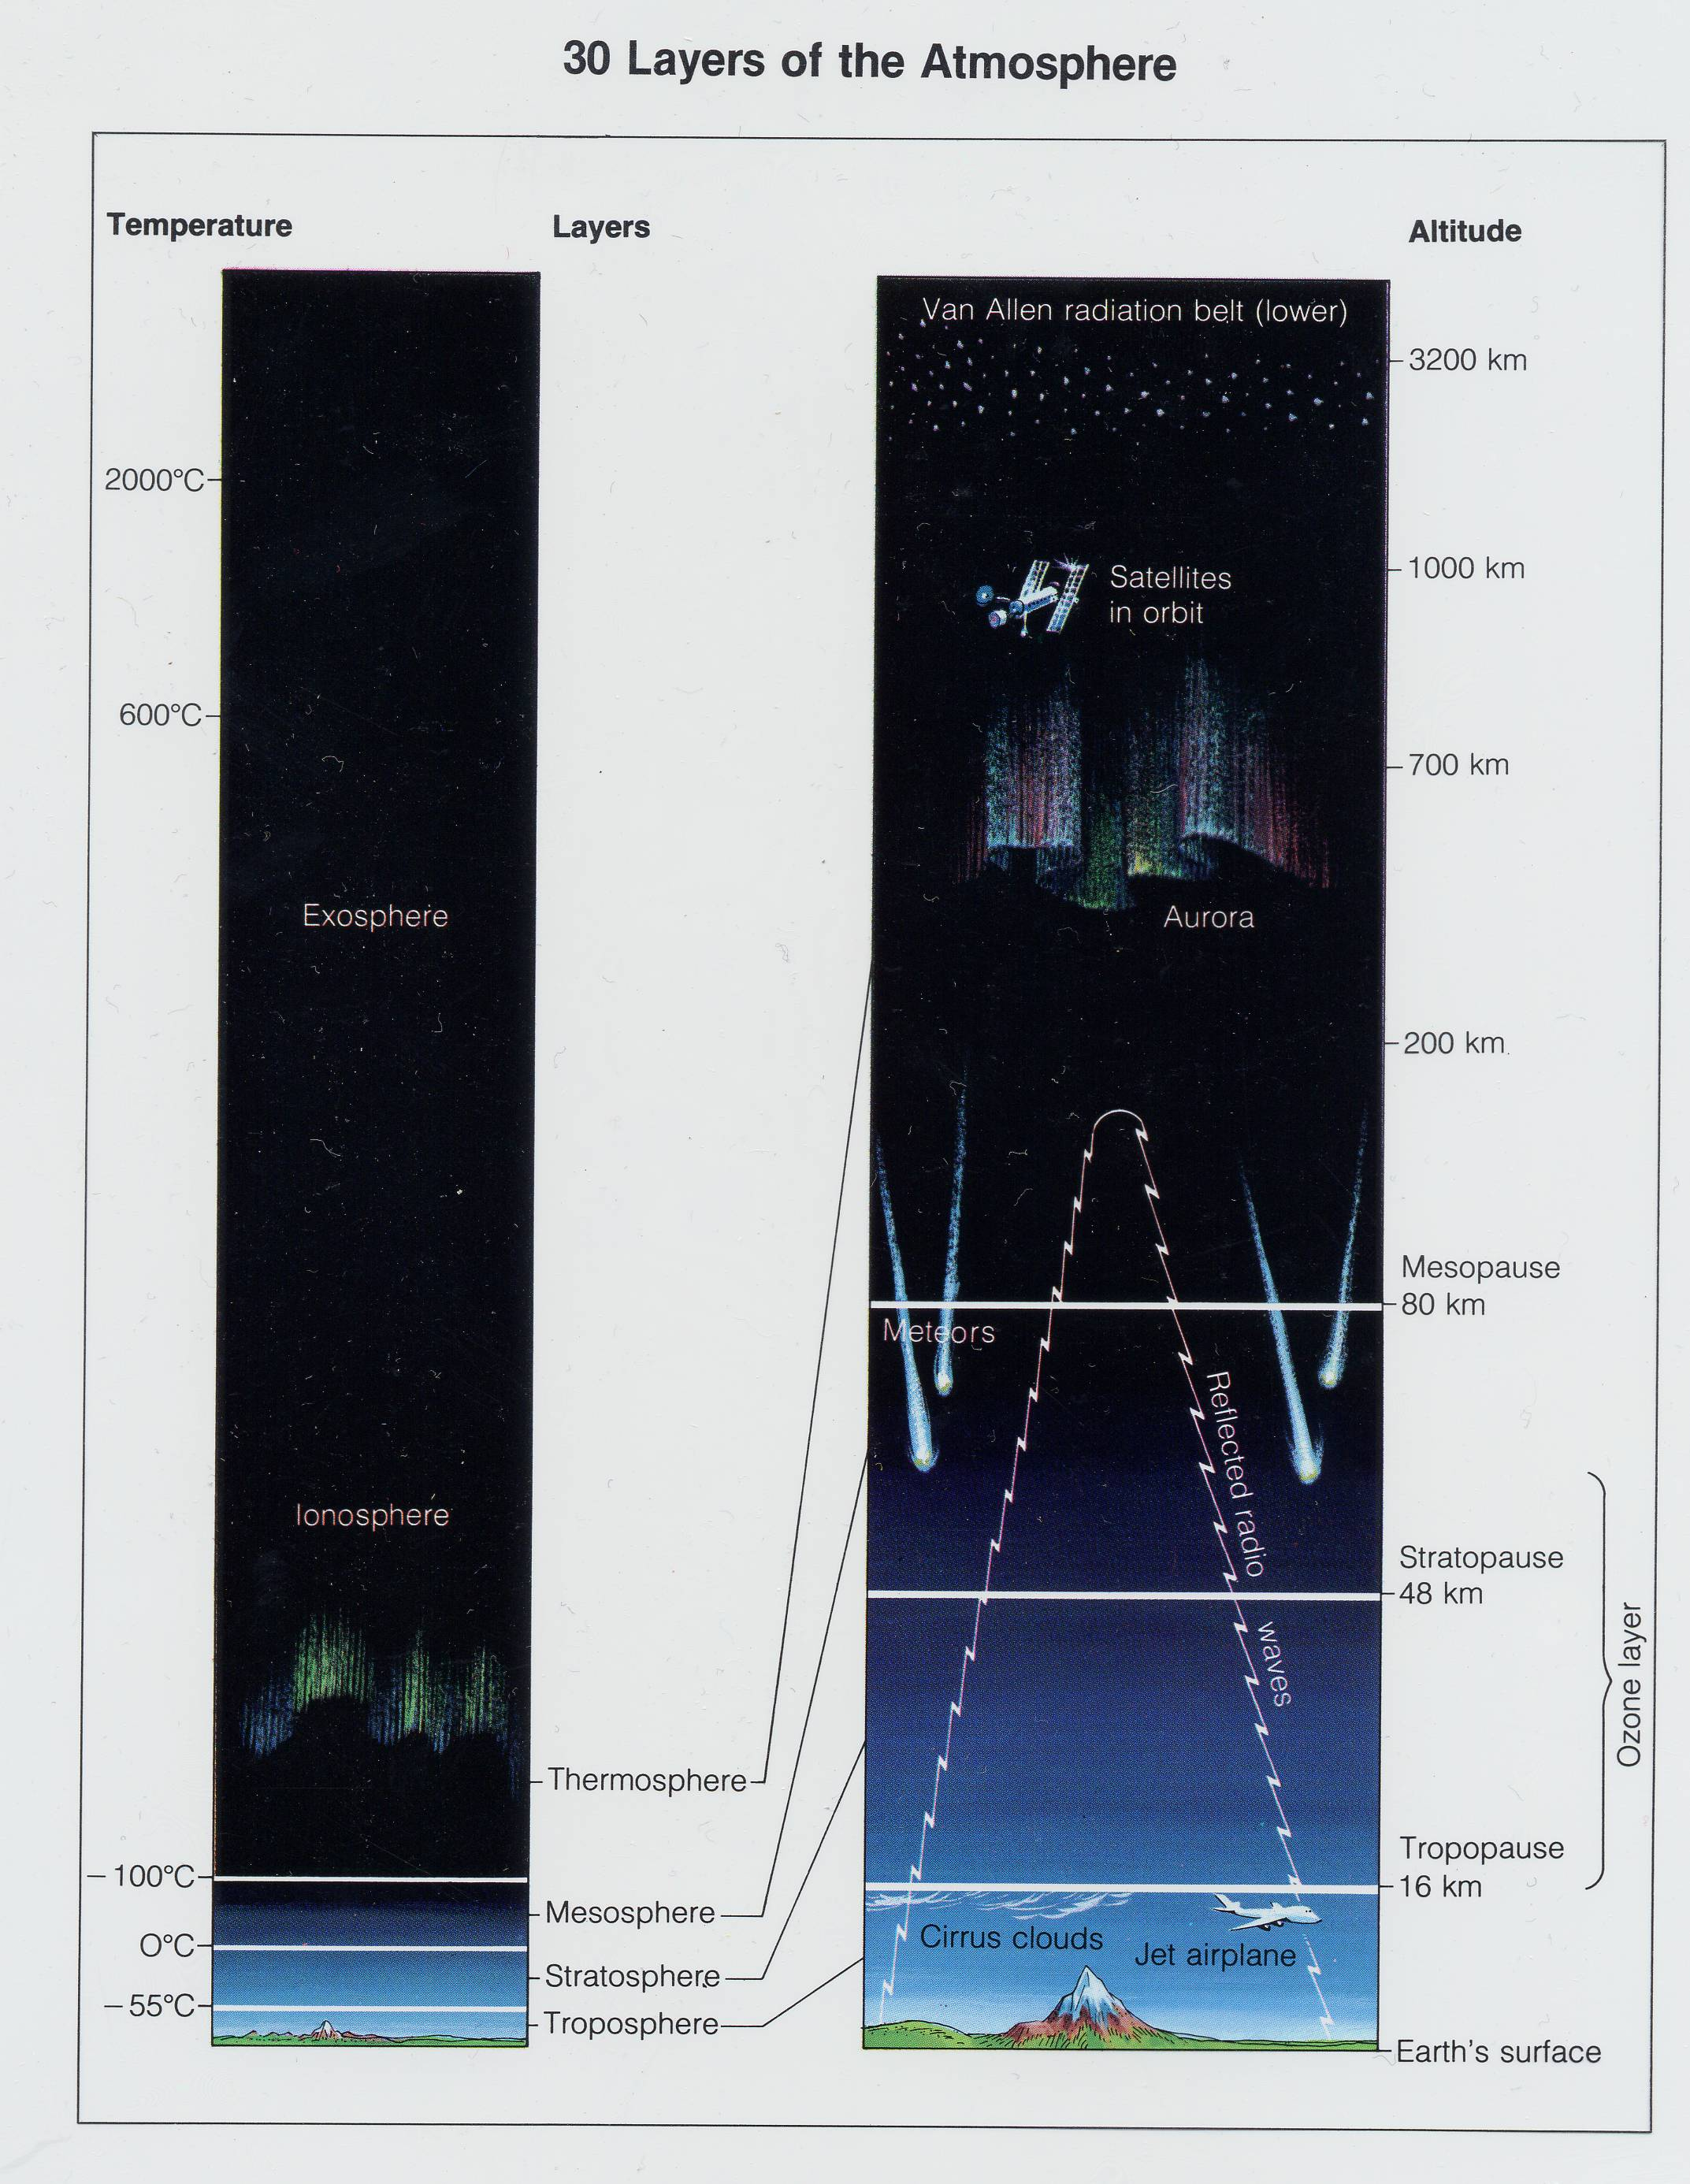
TEMPERATURE
Exosphere: -170° to 2,000°C
Thermosphere: -100 to 600° C
Mesosphere: -100° C to 0° C
Stratosphere: -55 to 0° C
Troposphere: -55 ° to 52 ° C

Slide 9
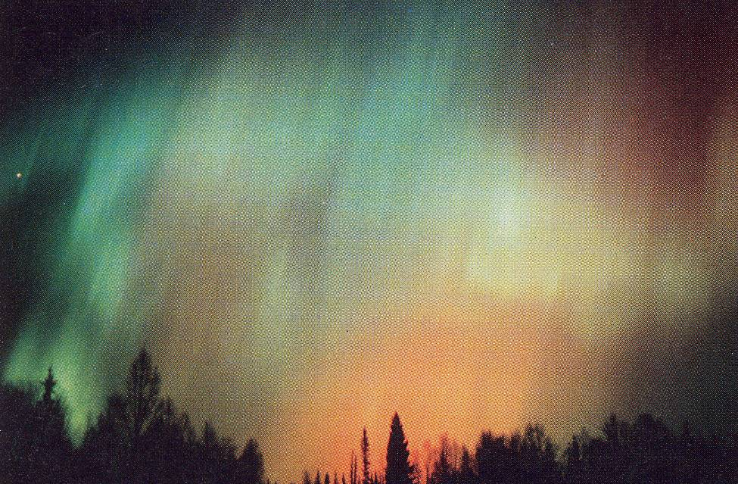
The Aurora Borealis is created when charged particles are excited in the atmosphere.

Slide 10
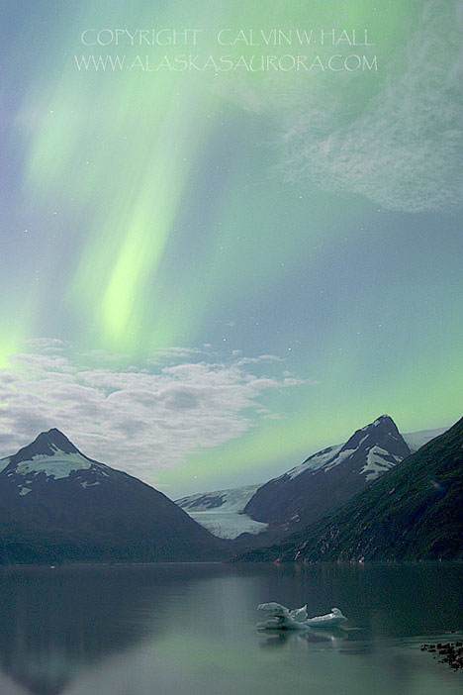
Aurora Borealis

Slide 11
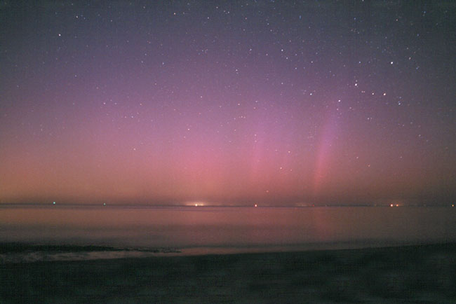
Aurora over Cape Cod

Slide 12
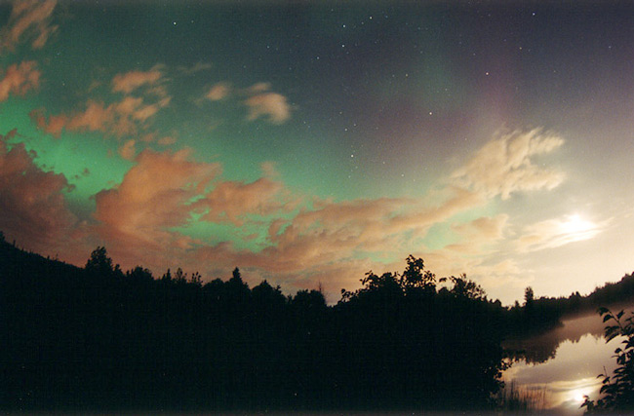
Aurora Borealis

Slide 13
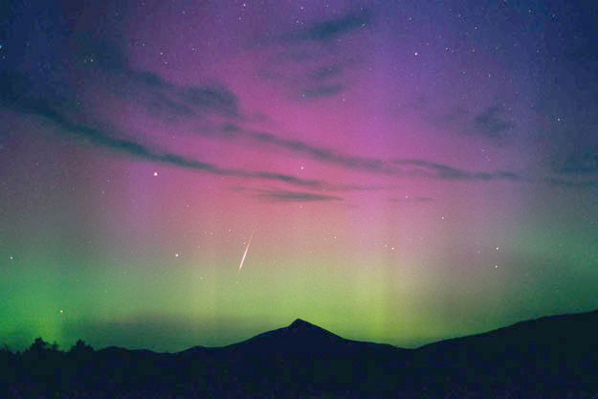
Aurora Borealis

Slide 14
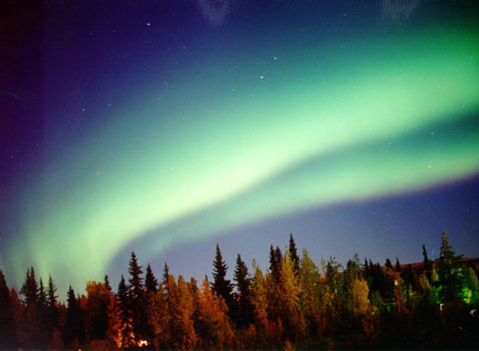
Aurora Borealis

Slide 15
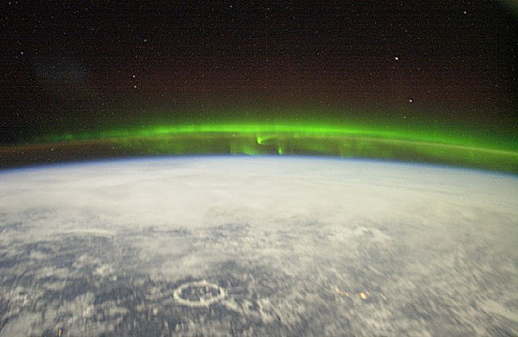
Aurora Borealis from space

Slide 16
Atmospheric Pressure
- Earth’s gravity pulls down on the molecules of gas in the atmosphere.
-The weight of gases at the top of the atmosphere press down on the air below, thus creating pressure.

Slide 17
Which container has HOT air? COLD air?
A
B
COLD AIR
HOT AIR
A colder atmosphere is going to apply more pressure to Earth’s surface.

Slide 18
Which container is at a HIGH elevation? LOW elevation?
A
B
Low Elevation
High Elevation
Atmospheric pressure will be greater at lower elevations.

Slide 19
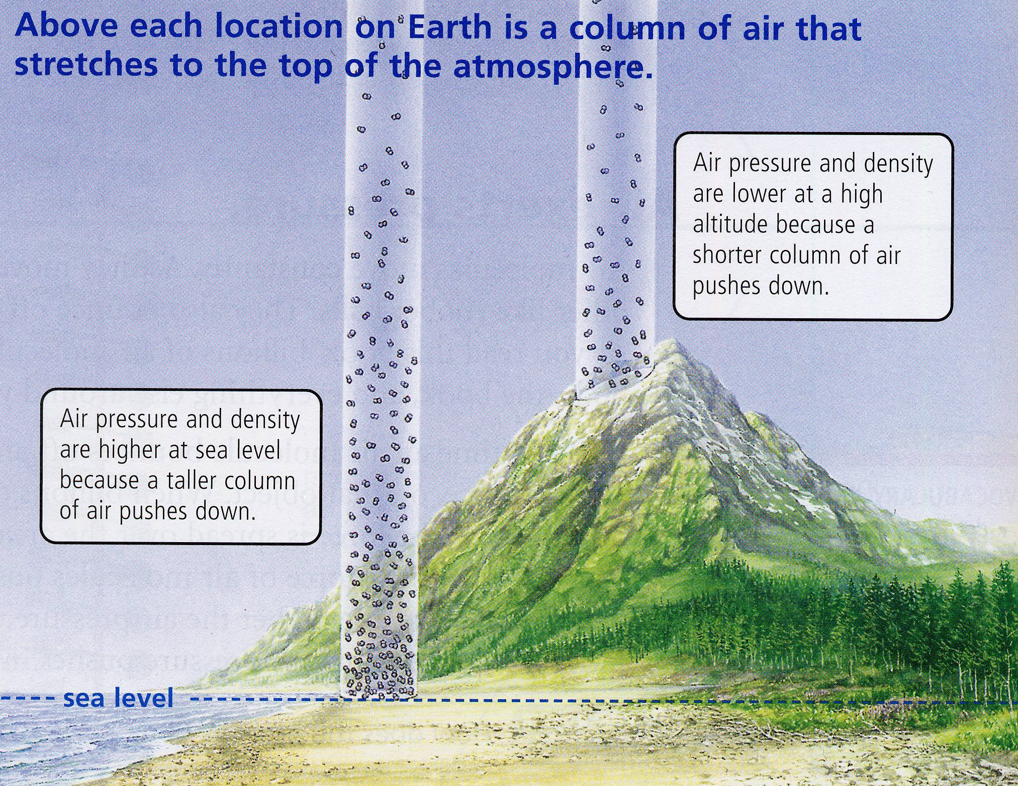

Slide 20
Why is it colder at higher elevations?
There are less molecules of air for the sun to heat up.

Slide 21
Why do you run out of breath faster if exercising at a higher elevation?
There is less air to breath at higher elevations.
Olympic athletes will often train at higher elevations to get used to less oxygen.

Slide 22
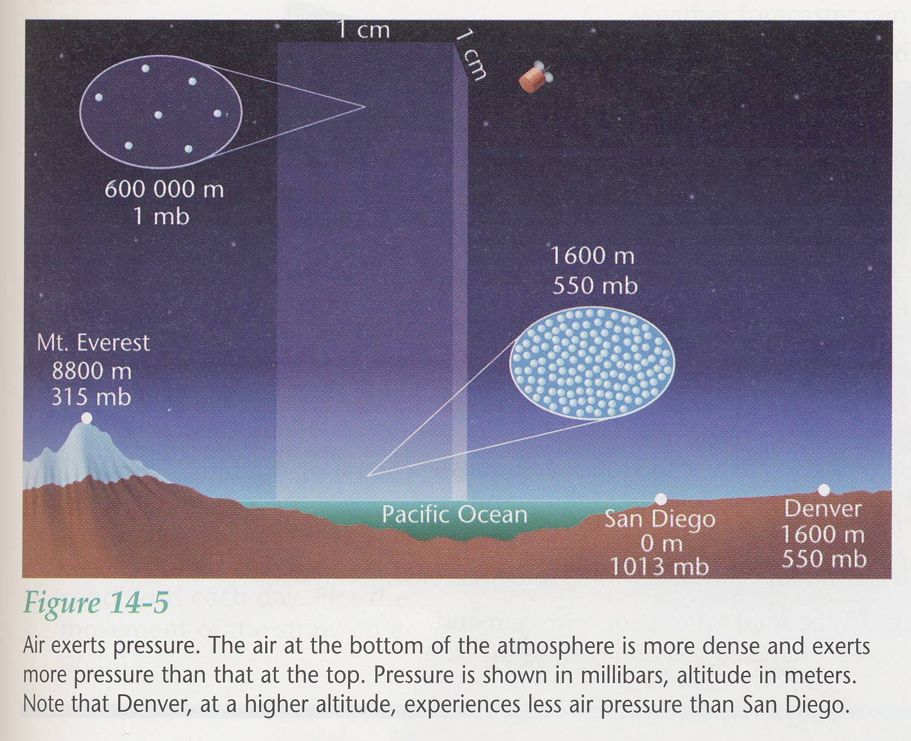

Slide 23
Since the atmosphere applies pressure on all things on the surface of Earth, why doesn’t it keep us flattened on the ground?
Atmospheric pressure is being applied to all exposed surfaces, even the undersides of objects.

Slide 24
HOT AIR = AIR PRESSURE
COLD AIR = AIR PRESSURE
LOW ELEVATION = AIR PRESSURE
HIGH ELEVATION = AIR PRESSURE

Slide 25

Atmospheric pressure is always trying to reach equilibrium.
IMPORTANT
RULE:
Air always moves from an area of high air pressure to an area of low air pressure.

Slide 26

What is created when atmospheric pressure tries to reach equilibrium?
WIND

